Slide 1

About Me
2nd-year Pulmonary-Critical Care Fellow
1st-year Master of Science in Clinical Investigation student
Pulmonary Division T32 Training Grant (2022-24)
Background: U of Colo Med School, U of Utah Internal Medicine and Chief year
Career: Academic P/CCM
Area of Interest: Hypercapnic Respiratory Failure Epidemiology and Health Services Research

Slide 2
Outline:
Definitions and ERS classification of OHS
Causes of hypercapnia: knowns and unknowns
Diagnosis: shortcomings and implications
Research aims and uses

Slide 3
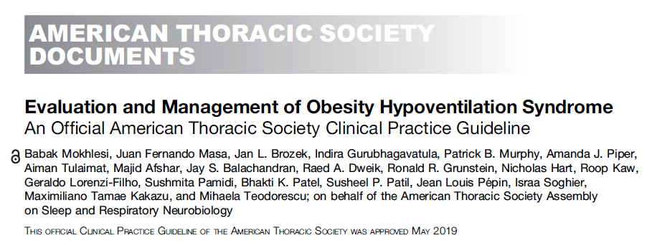
OHS as a model:
Definition:
BMI > 30 kg/m²
Sleep-disordered breathing
90% of patients with OHS have sleep apnea (AHI ≥ 5), 70% have severe sleep apnea (AHI ≥ 30). Other 10% have sleep hypoventilation
Awake hypercapnia (45 mmHg at sea-level; *43 mmHg at SLC)
Exclusion of other causes of hypoventilation
Problematic practically and philosophically
*insurers disagree
Notes:
Likely routine to you all, but this is often botched in pulmonary and inpatient medicine.
Exclusion parameter
In research studies: A patient with mild COPD cannot have OHS. In reality – what do you do with a patient who has COPD so mild that it doesn’t cause OHS? Or, if it’s mild enough that it wouldn’t cause hypercapnia on it’s own? Open questions, problem with the paradigm.
“Exclusion of other causes of hypoventilation
Severe obstructive respiratory disease
Severe interstitial lung disease
Severe chest-wall disorders (eg, kyphoscoliosis)
Severe hypothyroidism
Neuromuscular disease
Congenital hypoventilation syndromes”

Slide 4
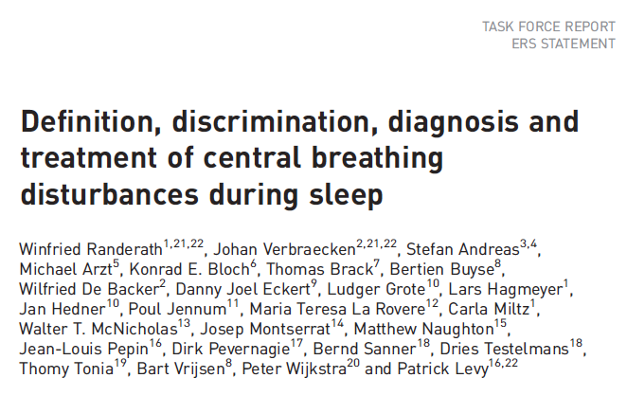
Pathogenesis
ERS Stage 0: At risk if BMI 30+; normal otherwise
HCO3- Level: Dashed
CO2 Level: Solid
Asleep
REM
Awake
Notes:
Hypoventilation, first at night
HCO3⁻ retention
Decreased Hypercapnic Ventilatory Response (HCVR)
Normocapnic obese vs. OHS differ in HCVR
Severe obesity alone is not sufficient; severe OSA alone is not sufficient
Transient CO2 load during apneic/hypopneic events -> kidneys retain HCO3
HCO3 excretion is slower than PCO2 – will persist into the day, depending on severity and the patients ability to hyperventilate or excrete HCO3 (absence of things causing metabolic alkalosis) during the day
If CO2 Loading/HCO3 retention is severe enough (or retention disordered) that it is not fully normalized, persistent HCO3 retention (met alkalosis) occurs
Excess HCO3 decreases the HCVR (change in PCO2 leads to buffered change in H+ CSF) -> hypoventilation and hypercapnia during the day.

Slide 5
Pathogenesis
ERS Stage 1: Obesity-associated sleep hypoventilation, intermittent
Physiology: HCO3- changes slower than CO2
HCO3- Level: Dashed
CO2 Level: Solid
Supine?
AHI up
Asleep
REM
Awake
Notes:
Hypoventilation, first at night
HCO3⁻ retention
Decreased Hypercapnic Ventilatory Response (HCVR)
Normocapnic obese vs. OHS differ in HCVR
Severe obesity alone is not sufficient; severe OSA alone is not sufficient
Transient CO2 load during apneic/hypopneic events -> kidneys retain HCO3
HCO3 excretion is slower than PCO2 – will persist into the day, depending on severity and the patients ability to hyperventilate or excrete HCO3 (absence of things causing metabolic alkalosis) during the day
If CO2 Loading/HCO3 retention is severe enough (or retention disordered) that it is not fully normalized, persistent HCO3 retention (met alkalosis) occurs
Excess HCO3 decreases the HCVR (change in PCO2 leads to buffered change in H+ CSF) -> hypoventilation and hypercapnia during the day.

Slide 6
Pathogenesis
ERS Stage 2: Obesity-associated sleep hypoventilation, sustained
Physiology: HCO3- retention
HCO3- Level: Dashed
CO2 Level: Solid
Asleep
REM
Awake
Notes:
Hypoventilation, first at night
HCO3⁻ retention
Decreased Hypercapnic Ventilatory Response (HCVR)
Normocapnic obese vs. OHS differ in HCVR
Severe obesity alone is not sufficient; severe OSA alone is not sufficient
Transient CO2 load during apneic/hypopneic events -> kidneys retain HCO3
HCO3 excretion is slower than PCO2 – will persist into the day, depending on severity and the patients ability to hyperventilate or excrete HCO3 (absence of things causing metabolic alkalosis) during the day
If CO2 Loading/HCO3 retention is severe enough (or retention disordered) that it is not fully normalized, persistent HCO3 retention (met alkalosis) occurs
Excess HCO3 decreases the HCVR (change in PCO2 leads to buffered change in H+ CSF) -> hypoventilation and hypercapnia during the day.

Slide 7
Pathogenesis
ERS Stage 3: sustained hypoventilation
Physiology: HCO3- lowers CO2 response
HCO3- Level: Dashed
CO2 Level: Solid
Asleep
REM
Awake
Notes:
Hypoventilation, first at night
HCO3⁻ retention
Decreased Hypercapnic Ventilatory Response (HCVR)
Normocapnic obese vs. OHS differ in HCVR
Severe obesity alone is not sufficient; severe OSA alone is not sufficient
Transient CO2 load during apneic/hypopneic events -> kidneys retain HCO3
HCO3 excretion is slower than PCO2 – will persist into the day, depending on severity and the patients ability to hyperventilate or excrete HCO3 (absence of things causing metabolic alkalosis) during the day
If CO2 Loading/HCO3 retention is severe enough (or retention disordered) that it is not fully normalized, persistent HCO3 retention (met alkalosis) occurs
Excess HCO3 decreases the HCVR (change in PCO2 leads to buffered change in H+ CSF) -> hypoventilation and hypercapnia during the day.

Slide 8
Pathogenesis
ERS Stage 4: sustained hypoventilation + cardiometabolic comorbidities
Physiology: increased risk of pHTN, etc.
HCO3- Level: Dashed
CO2 Level: Solid
Asleep
REM
Awake
Notes:
Hypoventilation, first at night
HCO3⁻ retention
Decreased Hypercapnic Ventilatory Response (HCVR)
Normocapnic obese vs. OHS differ in HCVR
Severe obesity alone is not sufficient; severe OSA alone is not sufficient
Transient CO2 load during apneic/hypopneic events -> kidneys retain HCO3
HCO3 excretion is slower than PCO2 – will persist into the day, depending on severity and the patients ability to hyperventilate or excrete HCO3 (absence of things causing metabolic alkalosis) during the day
If CO2 Loading/HCO3 retention is severe enough (or retention disordered) that it is not fully normalized, persistent HCO3 retention (met alkalosis) occurs
Excess HCO3 decreases the HCVR (change in PCO2 leads to buffered change in H+ CSF) -> hypoventilation and hypercapnia during the day.

Slide 9
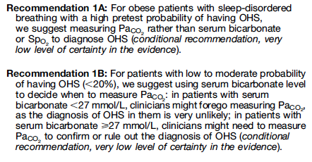
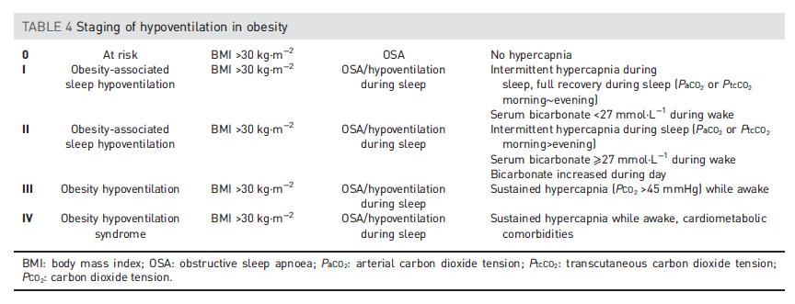
Pos Likelihood Ratio: 3.7
Neg Likelihood Ratio: 0.18
HCO3 > 27 predicting PaCO2 > 45
Notes:
Normal bicarbonate range should be: 23-30 Meq/L
https://cjasn.asnjournals.org/content/13/2/343
Normal elevation correction: per 1000m, 1.5 mEq/L lower

Slide 10
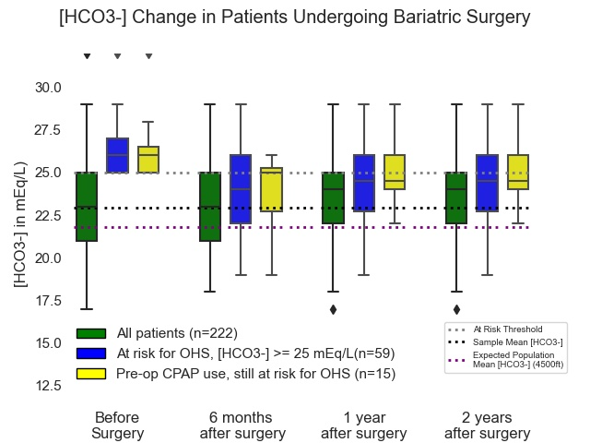
Slide on Project w Somya / Mishra. Add if fits and time

Slide 11
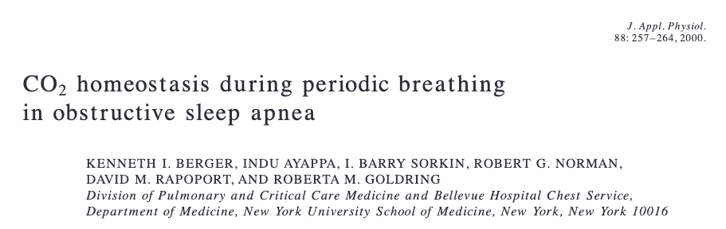
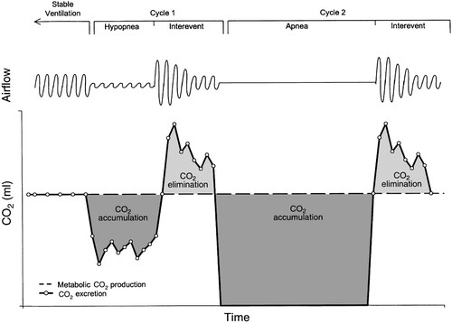
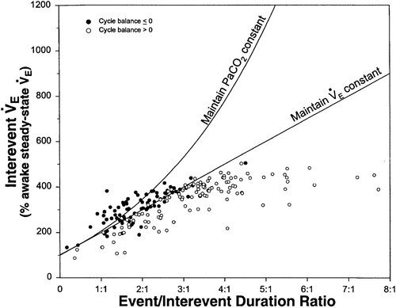
Pathophysiology
Notes:
Summary: as apnea duration increases and inter-event time decreases, the rate of ventilation between events required to maintain CO2 homeostasis increases.
(this explains why CPAP works in most OHS) https://doi.org/10.1152/jappl.2000.88.1.257
No relationship was seen between the CO₂ balance for each cycle and its interevent tidal volume or interevent ventilation. Positive CO₂ balance was not associated with a low interevent ventilation and occurred despite increased interevent ventilation to rates as high as 45 l/min.’
Thus, the authors infer the pathophysiology relates to **temporal** V/Q mismatching (as apposed to the usual **spatial** V/Q mismatch), rather than overall inability to compensate.
This is why they used Mixed Venous CO2 as a check – to ensure that temporal V/Q mismatching wasn’t compensated through changes in cardiac output
As the relative duration of the event increased (increasing ratios), there was a progressive increase in the interevent ventilation to a plateau at ratios >3:1. This plateau occurred at an interevent ventilation that was 450% of the awake steady-state value and reflects the maximum ventilation achieved by any patient during the interevent periods.
=➔ this would be different in someone who has pulmonary disease (or deconditioning) – limited in ability to increase
A model has been proposed where daytime hypercapnia can develop if sleep disordered breathing duration is sufficiently long or interapnea periods too short to restore ventilation and eucapnia (Berger et al., 2000). Berger and colleagues have suggested that gradual elevations in CO₂ occur over time since the ventilatory response to hypercapnia is insufficient compared to the rise in CO₂ which occurs during sleep.

Slide 12
OHS as a model:
Definition:
BMI > 30 kg/m²
Sleep-disordered breathing
90% of patients with OHS have sleep apnea (AHI > 5), 70% have severe sleep apnea (AHI > 30). Other 10% have sleep hypoventilation
Awake hypercapnia (Pa CO2v 45 mmHg at sea-level; *42 mmHg at SLC)
Exclusion of other causes of hypoventilation
Obesity -> increased CO2 production and vent limitation from mass of chest wall and disadvantaged respiratory mechanics
“Other Causes”: Obstructive lung disease, neuromuscular / chest wall disease, things that suppress ventilatory drive (opiates), or causes of metabolic alkalosis (loop diuretics)
Notes:
Other issues around diagnosic criteria:
VBG, EtCO2, or TcCO2 criteria?
Might arterial base-excess (titratable H+ excess) of either 3 or 2 (2 = 27 roughly) be a better parameter than HCO3?
Effect of ABG on hyperventilation - https://www.heartandlung.org/article/S0147-9563(16)30304-1/fulltext - Respiratory rate increased slightly during arterial puncture without any change in P_{ET}CO₂. Hence, acid–base status must be interpreted without the assumption of procedure induced hyperventilation.

Slide 13
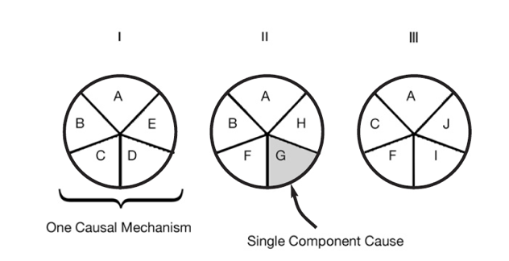
Sufficient-Component Cause Model
Sufficient cause: a set of factors that will cause disease when present
Component cause: a factor that, if not present, no disease would occur
Necessary cause: in all sufficient cause sets, this component must be present
3 Different Sufficient Causes
A = Necessary Cause
A – J = Component Cause
Notes:
Hypothesis
Rothman KJ. Am J Epidemiol 1976; 104: 587-592.
a sufficient cause as "...a complete causal mechanism" that "inevitably produces disease." Consequently, a "sufficient cause" is not a single factor, but a minimum set of factors and circumstances that, if present in a given individual, will produce the disease.

Slide 14
Causes of Hypercapnia
[Area represents a population of patients]
Severe COPD
Sufficient Cause
If PaCO2 > 52 mmHg, 2-4 weeks after exacerbation
*no other causes of ↑️ CO2
Notes:
Hypercapnic respiratory failure is uncommon and can be acute or chronic.
The symptoms are variable, and the diagnosis is frequently missed.
Each case of hypercapnic respiratory failure may have several necessary causes.
Prior research exclusively focused on sufficient causes
Perhaps effect modification?
Patients who develop hypercapnic respiratory failure have many comorbidities that may act as confounders

Slide 15
Causes of Hypercapnia
Obesity Hypovent
Sufficient Cause
BMI over 30, SDB, PaCO2>45
*no other causes of ↑️ CO2
Severe COPD

Slide 16
Causes of Hypercapnia
Obesity Hypovent
Severe COPD
ALS
Sufficient Cause
FVC <50%, nocturnal hypoventilation or sleep problems -> nocturnal ventilation improves outcomes
*no other causes of ↑️ CO2
Notes:
Hypercapnic respiratory failure is uncommon and can be acute or chronic.
The symptoms are variable, and the diagnosis is frequently missed.
Each case of hypercapnic respiratory failure may have several necessary causes.
Prior research exclusively focused on sufficient causes
Perhaps effect modification?
Patients who develop hypercapnic respiratory failure have many comorbidities that may act as confounders

Slide 17
Causes of Hypercapnia: Hypothesis
Obesity as Component Cause
Obesity Hypovent
COPD as Component Cause
Severe COPD
ALS
Muscular weakness as Component Cause
Notes:
This is my overall research goal to investigate

Slide 18
Causes of Hypercapnia: Hypothesis [ ] keep in
Sleep Apnea as Component Cause
Obesity as Component Cause
Obesity Hypovent
COPD as Component Cause
Loop Diuretics as Component Cause
Severe COPD
ALS
Opiates as Component Cause
Muscular weakness as Component Cause
Notes:
OSA: emphasize this
Hypercapnic respiratory failure is uncommon and can be acute or chronic.
The symptoms are variable, and the diagnosis is frequently missed.
Each case of hypercapnic respiratory failure may have several necessary causes.
Prior research exclusively focused on sufficient causes
Perhaps effect modification?
Patients who develop hypercapnic respiratory failure have many comorbidities that may act as confounders

Slide 19
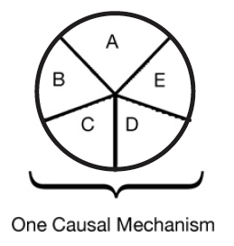
Multicausality
Hypothetical patient with hypercapnic respiratory failure
Sufficient cause: a set of factors that will cause disease when present
Component cause: a factor that, if not present, no disease would occur
Necessary cause: in all sufficient sets, this component must be present
COPD
Obesity
Loop diuretic
Untreated
Sleep Apnea
Opiates
Notes:
“Perhaps the most important of these principles is self-evident from the model: A given disease can be caused by more than one causal mechanism, and every causal mechanism involves the joint action of a multitude of component causes”’
“The importance of multicausality is that most identified causes are neither necessary nor sufficient to produce disease. Nevertheless, a cause need not be either necessary or sufficient for its removal to result in disease
prevention. If a component cause that is neither necessary nor sufficient is blocked, a substantial amount of disease may be prevented."
Rothman and Greenland

Slide 20
Is there evidence for multicausality?
Admitted to ICU with PaCO2 over 45 mmHg and a pH less than 7.35
Overall prevalence of OSA ( AHI > 30 ) in survivors over 50%
P (OSA | Hypercapnia) >> P (OSA)
*cause or correlation?
Notes:
Sleep apnea as sufficient cause? Kinda. Called OHS in that setting.

Slide 21
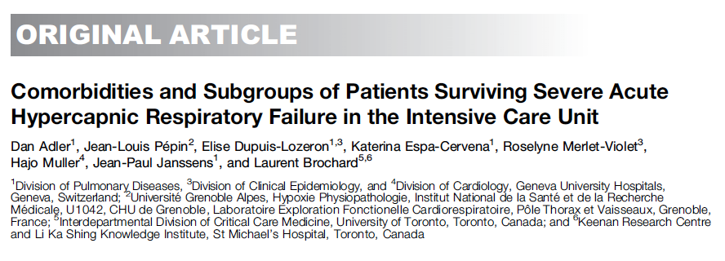
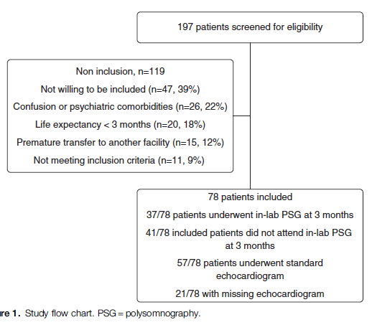
 | COPD (2/3) | No COPD (1/3)
Median [IQR] AHI | 31.9 [14.3, 45.6] | 66.0 [48.0, 83.8]
AHI > 5 present | 66% | 94%
AHI > 15 present | 51% | 81%
Notes:
N=78 patients, consecutive; Geneva. Recruited at ICU discharge after surviving PaCO2 over 6.3 kpa and requiring invasive or NIV. Exclude NM dz, iatrogenic, or with persisting confusion
21% had been hospitalized in the last yr for resp failure. 67% had COPD. 81 percent of patients without COPD were obese. 29% had OSA known (mostly untreated); 66% of those tested had mod-severe OSA. 51% had COPD&OSA. 44% had HFpEF, ~16%ish had pHTN
Patients who were not treated for OSA had higher readmissions (similar with others)

Slide 22
How often do patients fall into a group with evidence of treatment effect?
Cause | Treatment | Outcome Improved | LOE (Cochrane or ATS) | Criteria (*Resmed)
Restrictive Thoracic Dz | NIV | Hospitalization, Mortality | Meta-analysis of 3+ 3(mixed) RCTs Low | ABG w/ PaCO2 over 45 Sleep oximetry SpO2 < 88%
OHS | CPAP or BiPAP | CO2, O2, ED visits, and mortality. | Meta-analysis of 3 RCTs and 12 nonrandomized studies, Low | CPAP: Sleep study BiPAP: PaCO2 awake > 45 mmHg and FEV1 > FVC 70%
COPD | NIV | CO2, Hospitalization, QOL, dyspnea | Meta-analysis of 14 RCTs Moderate | PaCO2 over 45 or 52 Sleep oximetry SpO2 < 5 minutes on 2L or usual O2 OSA excluded or CPAP tried 2-4 weeks recovery from exac.
Neuromuscular Dz | NIV | Hospitalization, Mortality | Meta-analysis of 4+3 (mixed) RCTs Low | ABG w/ PaCO2 over 45 Sleep oximetry SpO2 < 88% MIP < 60cmH2o or FVC < 50%
*no trials of patient important in overlap syndromes have been done.
Notes:
COPD https://www.atsjournals.org/doi/full/10.1164/rccm.202006-2382ST
OHS: https://pubmed.ncbi.nlm.nih.gov/31726017/
Neuromuscular and chest D/O https://pubmed.ncbi.nlm.nih.gov/25503955/
https://document.resmed.com/documents/articles/1010293_RAD_Guidelines.pdf
What percentage of people who come in to the ICU meet those criteria?
Logistical problems: how many people get assessed if they do?
What other options are there? Pharm, etc.
GDMT
Compare to decompensated heart failure or decompensated heart failure
In a way, this is decompensated pulmonary failure.

Slide 23
Where do we draw this line? (who is included as a ’case’)
More on this*
All cases of hypercapnic respiratory failure
Sleep Apnea as Component Cause
Obesity as Component Cause
Obesity Hypovent
COPD as Component Cause
Loop Diuretics as Component Cause
Severe COPD
ALS
Opiates as Component Cause
Muscular weakness as Component Cause
Notes:
Hypercapnic respiratory failure is uncommon and can be acute or chronic.
The symptoms are variable, and the diagnosis is frequently missed.
Each case of hypercapnic respiratory failure may have several necessary causes.
Prior research exclusively focused on sufficient causes
Perhaps effect modification?
Patients who develop hypercapnic respiratory failure have many comorbidities that may act as confounders

Slide 24
Why does this matter?
Prevalence and Frequency of missed diagnosis
Implications of identifying hypercapnia

Slide 25
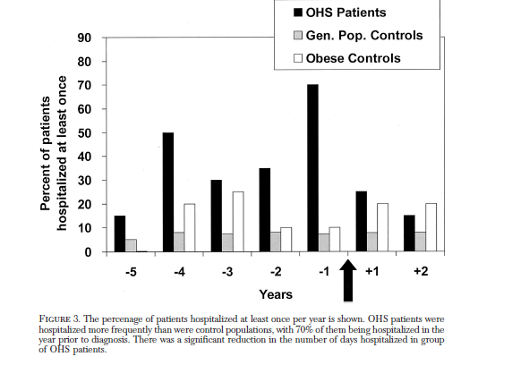
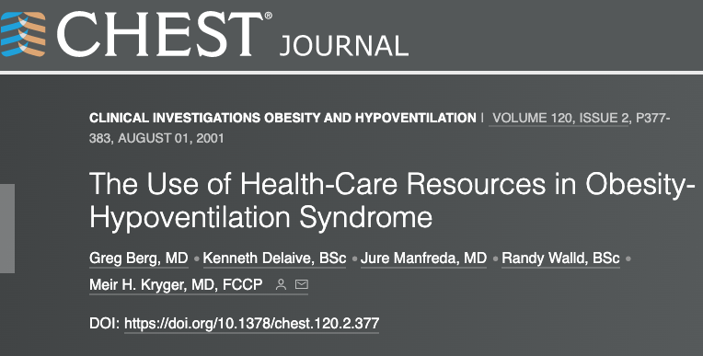
OHS and Hypoventilation Diagnosis
Diagnosis of OHS (and all hypoventilation disorders) occurs at:
Pulmonary or Sleep evaluation when compensated
During hospitalization when decompensated (acute-on-chronic resp. failure)
Different prognosis based on where diagnosis made
Utilization prior to diagnosis:

Slide 26
Hypercapnia Trajectories
Between Assessments
Assessment 2
Increasing CO2
Assessment 1
Normal CO2 on labs
Normalization of Hypercapnia
Normal CO2 on labs
Hypercapnia on labs
Hypercapnia (not identified)
Hypercapnia on labs
Recurrent Acute Hypercapnic Respiratory Failure (subtle diff. from chronic)
Acute Hypercapnic Respiratory Failure
Transient Hypercapnia? (hard to capture, hypothetical – opiates?)
Chronic Hypercapnic Respiratory Failure
Common: COPD, UT?
Common: OHS
Notes:
Do we know much about the relative proportion of these arrows? No. Probably Recurrent Acute and Acute = over-represented by current methods to identify. Yellow types may be most of what gets diagnosed in sleep clinic (vs hospitalization)
Acute Hypercapnia well tolerated, much research into acute management exists
For COPD – Green vs brick arrows … in HOT-HMV, roughly ¼ of patients who met inclusion criteria at discharge were no longer hypercapnic after 2-4 weeks. Not known how frequently resolution is for other causes
For OHS overall, roughly 50/50 present as the green arrow and the yellow arrow. The green arrow has a much worse prognosis than the yellow arrow.
In UT: more blue and orange arrow than green and yellow because hypoxemia is apparent.

Slide 27
Recurrent Acute Hypercapnic Respiratory Failure (subtle diff. from chronic)
Acute Hypercapnic Respiratory Failure
Transient Hypercapnia? (hard to capture)
Chronic Hypercapnic Respiratory Failure
In OHS ;
Yellow: Observational data suggests improved respiratory failure and sleep
Orange/Blue: 1 matched obs study: reduced readmission and mortality
In COPD, only yellow benefits: HOT-HMV (large RCT with 2-4 week gap before treatment), 21% of patients included had resolution by follow-up (blue or orange arrow)
Hypercapnic Overlap Syndrome? Excluded from both the above
Higher rates of re-admission (blue vs orange) than COPD alone.
Notes:
COPD meta-analysis / guideline: https://www.atsjournals.org/doi/full/10.1164/rccm.202006-2382ST
OHS meta-analysis / guideline: https://www.atsjournals.org/doi/10.1164/rccm.201905-1071ST
OHS readmission and mortality cohort
Mokhlesi B, Masa JF, Afshar M, et al. The Effect of Hospital Discharge with Empiric Noninvasive Ventilation on Mortality in Hospitalized Patients with Obesity Hypoventilation Syndrome. An Individual Patient Data Meta-Analysis. Ann Am Thorac Soc. May 2020;17(5):627-637. doi:10.1513/AnnalsATS.201912-887OC

Slide 28

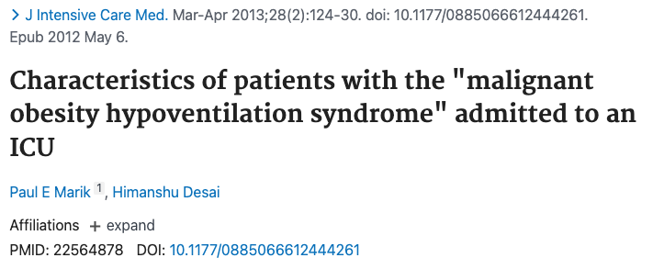
Frequency of missed diagnoses
2005, Denver. Consecutive admissions of patients with BMI over 35. Excluded COPD or prior lung resection. 31% had PaCO2 over 45*. In subgroup of BMI over 50, 48% did.
Only 23% diagnosed with OHS, 13% commenced on PAP after discharge.
Reviewed all admissions with PaCO2 over 45 and BMI over 40.
75% misdiagnosed with OHS despite not having evidence of obstruction on PFTs
Notes:
30 Nowbar S, Burkart KM, Gonzales R et al. Obesity-associated hypoventilation in hospitalized patients: prevalence, effects, and outcome. Am J Med 2004;116:1-7
Nowbar: Of 277 patients with a BMI ≥35 kg/m² admitted to an inpatient medical service, Nowbar and colleagues⁴ found that 31% met criteria for OHS. when a subgroup of patients with BMI greater than 50 kg/m² was examined, OHS was found in 48%. Of particular concern, (though likely representative of many hospitals), effective therapy for hypoventilation was only instituted in 13% of these patients.
Predicting OHS
32 Bulbul Y, Ayik S, Ozlu T, Orem A. Frequency and predictors of obesity hypoventilation in hospitalized patients at a tertiary health care institution. Ann Thorac Med 2014;9:87-91.
45. Javaheri S, Simbartl LA. Respiratory determinants of diurnal hypercapnia in obesity hypoventilation syndrome. What does weight have to do with it? Ann Am Thorac Soc. 2014;11:945-950

Slide 29
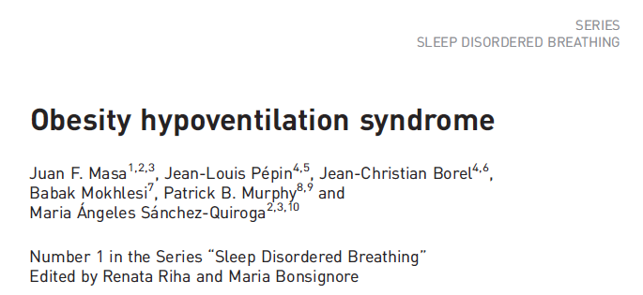

OHS prevalence - Outpatients
Fermi Estimate of Prevalence 1 in 260 US adults
7.6% of adults US population BMI 40+
Rate of OSA in BMI 40+ = ~ 50%
Rate of OHS in severe OSA = ~10%
Cleveland Clinic; universal etCO2 before bariatric surgery
Prevalence: 68.4% by EtCO2 > 45 or HCO3 over 27.
Notes:
Bariatric surgery screening for OHS:
Tran, Wang, Gharaibeh, et al.: Bariatric Surgery Risk in Obesity Hypoventilation - A total of 1,718 patients undergoing polysomnography with end-tidal CO2 monitoring prior to bariatric surgery at Cleveland Clinic from September 2011 to September 2018 were included.”
Key Findings: “OHS prevalence was 68.4%. Unadjusted analyses revealed a 1.5% increased odds of OHS (1.01; 1.00-1.03) per 1-unit BMI increase, 1.7% (1.02; 1.01-1.02) per 1% increase in sleep time Sa_{O2} < 90%, 12% increase (1.12; 1.03-1.22) per 1-U increase in hemoglobin A1c, and 3.4% increased odds (1.03; 1.02-1.05) per 5-U increase in apnea-hypopnea index. The association of apnea-hypopnea index with OHS persisted after adjustment for age, sex, race, and BMI and its comorbidities (1.02; 1.01-1.04)”
“In a single-center retrospective study of morbidly obese patients admitted to the intensive care unit because of hypercapnic respiratory failure due to obesity hypoventilation, 75% had been erroneously diagnosed and treated for COPD, and 86% were being treated for congestive heart failure (36).”
“Marik and Desai reported that 8% of all admissions to a general ICU with acute-on-chronic hypercapnic respiratory failure met diagnostic criteria for OHS (22). “
Marik PE, Desai H. Characteristics of patients with the “malignant obesity hypoventilation syndrome” admitted to an ICU. J Intensive Care Med 2013;28:124–130.
BMI over 50+ - high rates
The CDC estimated that 7.6% of the adult U.S. population has a BMI ≥40 kg/m² (https://pubmed.ncbi.nlm.nih.gov/29922829/).

Slide 30

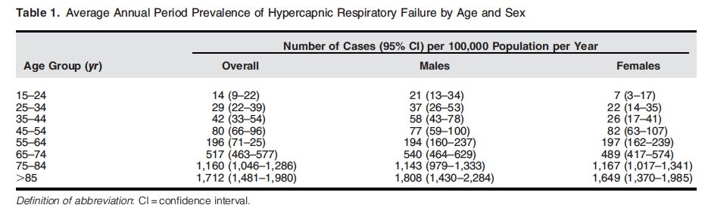
Prevalence of hypercapnic resp failure inpatient
Australia, 2013-2017. First ABG w/n 24h of presentation: PaCO2 45+ (min. est)
Excluded VBG, out-of-hospital cardiac arrest, traumatic injury, or sedation
163 per 100k person-year (~=PE)
Acidosis (acute) in 55%
“Compared to those aged 45 to 54 years, each successive decade of life conferred increases [risk] by 2.1, 6.2, 15.7 and 26.2 times”
Notes:
Ballpark, this is about similar to admission with Pulmonary Embolism.
(causal implication is slightly different)

Slide 31
Why does this matter?
Prevalence and Frequency of missed diagnosis
Implications of identifying hypercapnia

Slide 32
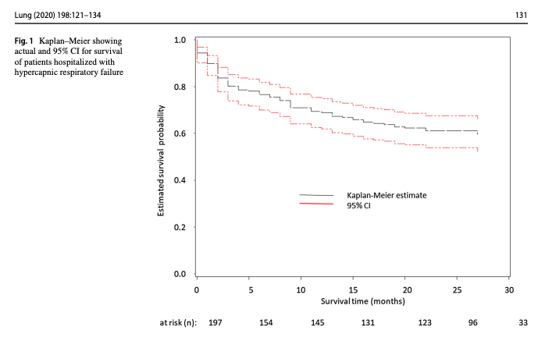
Notes:
ICD 10 diagnostic codes [J96.02 (acute HRF), J96.22 (acute and chronic respiratory failure with hypercapnia), J96.92 (respiratory failure unspecifed with hypercapnia), J96.12 (chronic respiratory failure with hypercapnia), E66.2 (morbid obesity with hypoventilation)]
https://link.springer.com/content/pdf/10.1007/s00408-019-00300-w.pdf UVM
202 patients admitted with acute hypercapneic resp failure
Identified by ICD code.
Comorbs: 29% CHF, 24% OSA, 6% OHS, 46% COPD, 10% Asthma
Admission reason: 50% resp failure, 11% pneumonia, 23% AECOPD, 5% overdose, 12% sepsis, 29% cardiac disease
23% readmission within 30 days; higher with peripheral vascular disease, active smoking, ILD and Bronchiectasis; increased with compensation (bicarb 40-49 vs 20-29)

Slide 33
Notes:
Inclusion criteria: Admitted, 18+
ABG showing PaCO2 over 45 and pH 7.35-7.45 during 2018. N=491
44% had multiple admissions w/n the year
44.2% mortality over a median of 592 days
Manual review of 40 patients with 0 competing metabolic proceses.

Slide 34
Where do we draw this line? (who is included as a ’case’)
More on this*
All cases of hypercapnic respiratory failure
Sleep Apnea as Component Cause
Obesity as Component Cause
Obesity Hypovent
COPD as Component Cause
Loop Diuretics as Component Cause
Severe COPD
ALS
Opiates as Component Cause
Muscular weakness as Component Cause
Notes:
Returning to this:
I’ve presented data primarily about this little circle; need epidemiologic definitions to build cohorts about the whole group.

Slide 35
How is the current literature identifying hypercapnia?
Diagnostic Code-Based
Admitted (ICU or floor) with one of the following diagnostic codes:
J96.02 (acute hypercapnic respiratory failure)
J96.22 (acute and chronic respiratory failure with hypercapnia)
J96.92 (respiratory failure unspecifed with hypercapnia)
J96.12 (chronic respiratory failure with hypercapnia)
E66.2 (morbid obesity with hypoventilation)

Slide 36
Currently, how is hypercapnia identified?
Lab-Based
Admitted to hospital (Floor or ICU) with ABG showing PaCO2 over 45 mmHg and pH 7.35-7.45

Slide 37
Currently, how is hypercapnia identified?
Lab and procedure code-Based
Admitted to the ICU
PaCO2 greater than 47.25 mmHg
Procedure code for non-invasive ventilation or invasive mechanical ventilation initiation

Slide 38
Currently, how is hypercapnia identified?
Lab-based, with additional review
Inpatients (ICU or Floor)
All patients with an initial ABG PaCO2 over 45, “excluded iatrogenic causes/sedation”.
Notes:
https://www.atsjournals.org/doi/full/10.1164/rccm.202108-1912LE?af=R
Limitations: unable to assess comorbidities or causes
Blood gasses may undersampble

Slide 39
Project 1: Hypotheses
The methods used in prior studies of hypercapnic respiratory failure identify different patients
Hypothesis 1: the sensitivity (aka recall) and positive predictive value (aka precision) for both billing code- and procedural code-based identification of hypercapnic respiratory failure will be below 80%, when compared to blood gas-based identification as the reference standard.
The populations identified by differ in risk for outcomes of interest, which hampers interpretation of these studies.
Hypothesis 2: The distribution of age, ethnicity, BMI, Elixhauser comorbidity score, and frequency of coexisting diagnoses (OSA, opiate use disorder, COPD, CHF, and neuromuscular disease) will differ between the cohorts identified by each method.
Notes:
Will discuss why not Se and Sp
Will discuss why blood gas taken as a reference standard.
Hypothesis 2: The distribution of age, ethnicity, BMI, Elixhauser comorbidity score, and frequency of coexisting diagnoses (OSA, opiate use disorder, COPD, CHF, and neuromuscular disease) will differ between the cohorts identified by each method.

Slide 40
Data source:
69 million MRNs; ~50 academic medical centers (including U of U)
De-identified, patient-level data (not PHI, though recommended to be treated as such)
Missing Data?
Data Available | Data unavailable
Demographics Diagnosis Medications Procedures - what procedures were done. E.g. sleep study code Labs Cancer registry (NAACCR) Allergies | Some notes* Diagnostic reports DICOM image objects Providers Departments/clinics

Slide 41
We requested patient level data from all records with an inpatient encounter and any of:
Diagnostic code for respiratory failure
Included all types
Arterial Blood gas with hypercapnia (45 mmHg+)
Procedure code for initiation or management of NIV or IMV
N=~800,000 patients.
Notes:
(bolded = correct classifications for hypercapnia; non-bolded = incorrect, but likely common, misclassifications of hypercapnia)
J96.12 (chronic respiratory failure with hypercapnia),
J96.02 (acute hypercapneic respiratory failure),
J96.22 (acute and chronic respiratory failure with hypercapnia),
J96.92 (respiratory failure unspecified with hypercapnia),
E66.2 (morbid obesity with hypoventilation)
J96 Respiratory Failure, not otherwise specified
J96.00 Acute Respiratory Failure, unspecified whether hypoxia or hypercapnia
J96.01 Acute respiratory failure, with hypoxia
J96.1 Chronic Respiratory Failure
J96.10 Chronic Respiratory Failure, unspecified whether hypoxia or hypercapnia J96.11 Chronic Respiratory Failure with hypoxia
J96.2 Acute and Chronic Respiratory Failure
J96.20 Acute and Chronic Respiratory Failure, unspecified whether hypoxia or hypercapnia
J96.21 Acute and Chronic Respiratory Failure, with hypoxia
J96.90 Respiratory Failure, unspecified whether with hypoxia or hypercapnia (most common in TrinetX)
J96.91 Respiratory Failure, unspecified with hypoxia
Specific Procedure Codes:
Assistance with Respiratory Ventilation, 0-24 hours; 24-96 hours; and longer than 96 hours
Management of non-invasive ventilation
Respiratory Ventilation, 0-24 hours; 24-96 hours; and longer than 96 hours
Ventilator Management
Ventilation Assist and Management.. initial; first day; and subsequent day
ICD-10: Mechanical Ventilation - 5A1935Z, 5A1945Z, 5A1955Z
Specific Blood gas codes:
LOINC 2019-8 Carbon Dioxide [ Partial Pressure ] Arterial Blood over 45
LOINC 2026-3 Carbon Dioxide, total [ Moles/Volume] in Arterial Blood over 45
LOINC 32771-8 Carbon Dioxide [ Partial Pressure] adjusted to patient’s actual temperature in arterial blood over 45
LOINC 11557-6 Carbon Dioxide [ Partial Pressure] in Blood

Slide 42
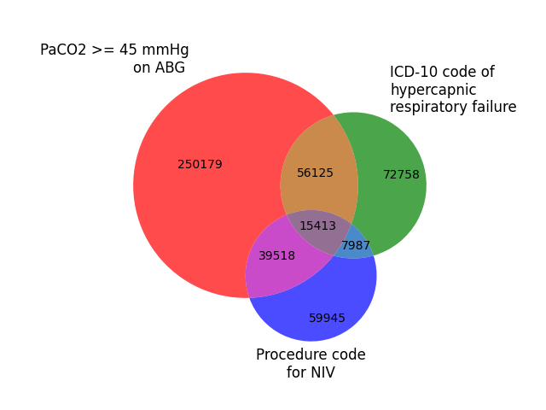
Preliminary Results
Using TriNetX Embedded Tools*
ICD Group:
Relative sensitivity (vs ABG): 19.8%
Positive Predictive Agreement (vs ABG): 47.0%
NIV Group:
Relative sensitivity (vs ABG): 15.2%
Positive Predictive Agreement (vs ABG): 45.2%
Notes:
Why start with inpatients with Hypercapnia?
Easier ascertainment
Informed presence bias
Labs
Data sources
Higher morbidity

Slide 43
Preliminary Results
 | ABG Group | ICD Group | NIV Group
Age | 62±18 | 65±16 | 62±17
% Female | 46% | 51% | 42%
% white | 66% | 71% | 65%
% Black | 18% | 19% | 17%
BMI | 30.4±8.3 | 33.1±10.3 | 29.1±8.2
% with CHF | 37% | 30% | 19%
% with COPD | 31% | 30% | 14%
% Opiate UD | 6% | 3% | 3%
% Sleep Apnea | 23% | 24% | 10%

Slide 44
Implications:
For accurate determination of
Frequency of different comorbidities or causes
Morbidity and mortality associated with hypercapnia
Who should be included in studies to determine benefit from treatment
... method of patient identification likely matters
Interpretability of current research could be improved using standard case definitions

Slide 45
How should we identify these patients (for studies)? Next Steps
What should the reference standard be?
Does transient elevation PaCO2 after opiate administration imply respiratory failure?
Technically yes, but the implication of the diagnosis is much different
How much heterogeneity should the definition have?
Current PaCO2 threshold (45mmHg at sea level; 42-3 mmHg in SLC) are arbitrary (No epidemiologic data to support).
Different threshold by cause (NIV in COPD 52 mmHg; 45 mmHg other)
Informed presence bias: people who have information in the EHR differ from those who do not.
Who should get an ABG?
Notes:
Informed presence bias: people who have information in the EHR differ from those who do not.
What would the ABG have shown, if it were checked? Hard to predict
EHR Computable Phenotype: an algorithm to classify patients based on the information present in the EHR
EHR Computable phenotype for Hypercapnic Respiratory Failure?
What should the reference standard be?
Physician adjudication? Chart Review
Based on some outcome measure: ie, risk of mortality or readmission
Uses:
Epidemiology: Prevalence Estimates
Conditional Probabilities for Diagnosis
Clarification of burden of disease; coverage of treatment modalities
Cohort or Trial enrollment
Prediction of patients in need of blood gas assessment or capnography

Slide 46
5 Takeaways:
Patients with hypercapnic respiratory failure of any cause frequently have OSA, whether or not it’s ‘OHS’
OHS, and likely other causes of hypercapnia, are frequently undiagnosed. When diagnosed, it’s usually in sleep/pulm clinic or at hospitalization.
HCO3- may be a useful screen, though uncertainty around the generalizability and course of hypercapnia limit our knowledge.
Hospitalization with hypercapnia is about as common as PE. Readmission rates are higher than CHF, pneumonia, and COPD exacerbations. Mortality rates are high
Better epidemiologic definitions are needed before progress can be made

Slide 47
Statistical Analysis Plan: why not Se/Sp?
Example Calculation | ICD code = ‘Prediction’ | ICD code = ‘Prediction’
Blood gas = reference standard |  | ICD Code for Hypercapnic RF | No ICD code for Hypercapnic RF
Blood gas = reference standard | PaCO2 >= 45mmHg | True Positive | False Negative | Sensitivity TP / (TP + FN) (=Recall)
 | PaCO2 < 45mmHg (or no ABG) | False Positive | True Negative [Huge Number, not very informative] | Specificity TN / (TN + FP)
 |  | PPV TP / (TP + FP) (=Precision) | NPV TN / (TN + FN)
Notes:
Precision-Recall = Information Retrieval Terminology
Sensitivity = aka recall
PPV = aka precision
These indices are preferred when there is an imbalance In the in presence/absence of disease (ie, people without hypercapnic RF are much more common) – Se / Sp not wrong, but also not maximally informative.
FDA language for what to call the metrics when there is no guidance
Relative Sensitivity
Positive percent agreement

Slide 48
PA_{O2} = (P_{atm} – P_{H2O}) * Fi_{O2} – (Pa_{CO2} / RQ) + Fi_{O2} * Pa_{CO2} * (1-RQ)/RQ
Normal A-a gradient? 4 + (0.25 * Age)
Critical PAO2 = paO2 + (Normal A-a gradient)
Notes:
What the way that people present in UT (or other places at elevation) may be different than at sea level.
Hypercapnia is largely iatrogenic: without supplemental oxygen, people with hypercapnia wouldn’t persist – especially if they had concomitant lung disease.
This also makes sense why these people might be so frail and prone to readmission… as your PaCO2 goes up, your buffer goes down. In fact, that’s probably why we’re evolved to hyperventilate with altitude. – called referred to as “ventilatory acclimatization” (92).
Lastly: PaCO2 increases exponentially as VE decreases linearly (think of CO2 clearance and how GFR-sCr relates)

Slide 49
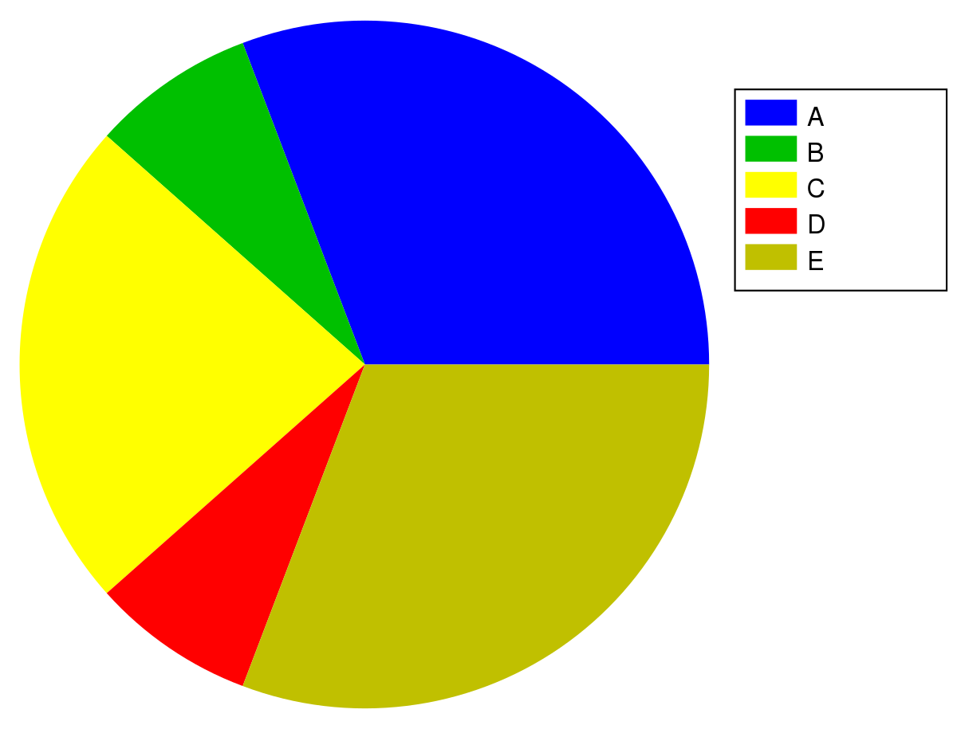
1. Theoretical distribution of causes of hypercapnic respiratory failure
Weak testing evidence required
Strong testing evidence required
Diagnosis
Prevalence Estimates (USA):
CHF: AHA estimate = 1.8%
COPD: CDC estimate = 6.3%.
OSA w/ AHI over 15: 7% (Wisconsin Sleep Cohort Study)
2. Conditional probabilities:
P (Hypercapnic Resp Failure | Condition) = P ( HRF and condition) / P (Condition)
Notes:
[ ] update this slide for
“What clinicians really want to know is the opposite direction of conditional probability—the chance that someone with lymphadenopathy has lupus, ie, the positive predictive value. The Bayes theorem teaches that the prevalence, or prior probability, and the specificity of the finding connect these 2 conditional probabilities (sensitivity and positive predictive value). For diagnosticians, this problem-solving activity is iterative; comparing the list of the person’s findings with the disease profiles will help guide acquisition of new information and revise the list of potential diagnoses (eg, a negative antinuclear antibody test result might rule out lupus). The exercise requires that physicians learn how to access information about the accuracy of tests derived from scientific knowledge, such as sensitivity and specificity or likelihood ratios.” from https://jamanetwork.com/journals/jama/fullarticle/2791519

Slide 50
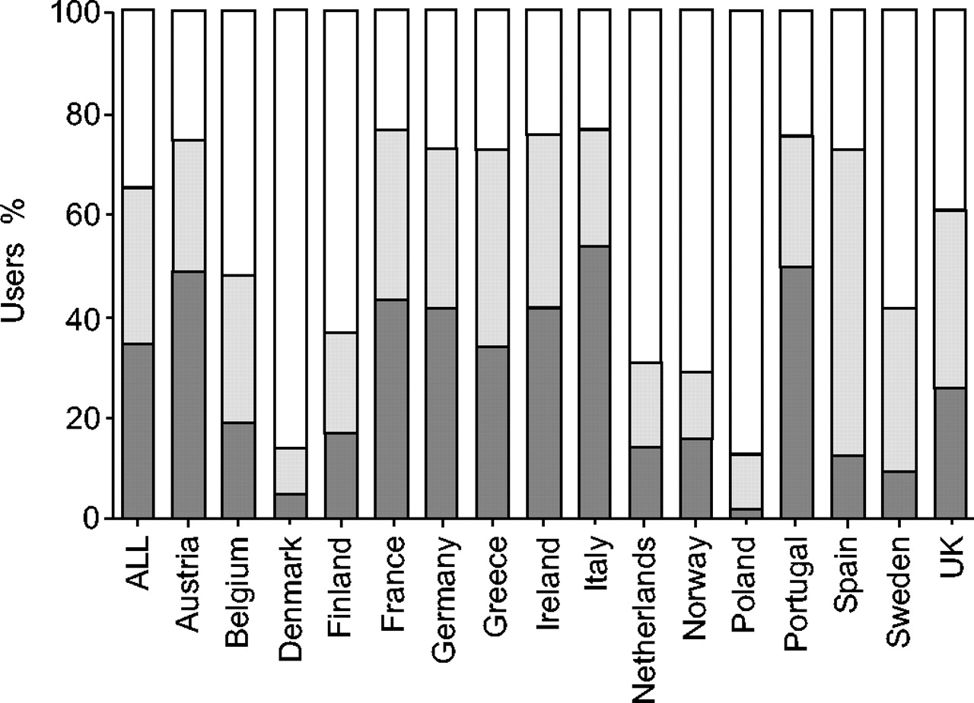
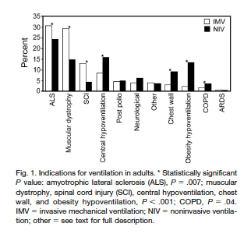
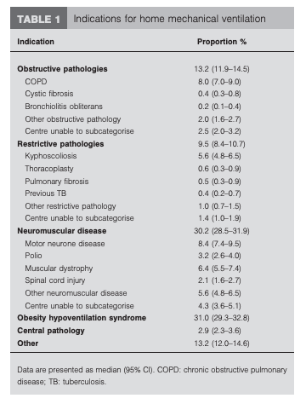
Reasons for Home NIV
Percentage of users in each disease category by country (see Methods section for an explanation of disease categories). ▪: lung/airways; : thoracic cage; □: neuromuscular.
Euvoven: 6.6 per 100k DOI: 10.1183/09031936.05.00066704
Canada (Canuvent): DOI: https://doi.org/10.4187/respcare.03609
AUS/NZ: DOI: 10.1183/09031936.00206311
S. J. Lloyd-Owen et al. Eur Respir J 2005;25:1025-1031

Slide 51
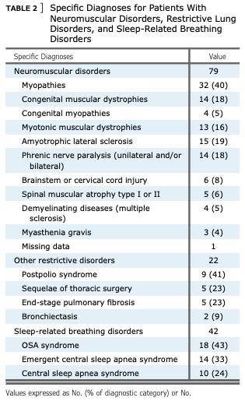
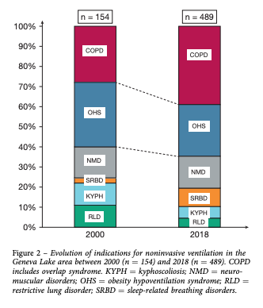
Trends- DOI: https://doi.org/10.1016/j.chest.2020.02.064
“The population of patients under chronic NIV has also changed, from the initial predominantly restrictive indications (sequelae of TB, postpolio syndrome, chest wall disorders, and neuromuscular disorders) to a progressive increase of patients with chronic respiratory failure (CRF) because of obesity hypoventilation syndrome (OHS), COPD, and overlap syndromes which started in the late 1990s”
Obesity was highly prevalent: BMI was $ 30 kg/m2 in 270 patients (55%), $ 35 kg/m2 in 180 patients (37%), and $ 40 kg/m2 in 106 patients (22%).
NIV was initiated electively in 247 subjects (50%) vs in an emergency setting for 220 (45% of all patients; not specified for 22 patients; 5%). Most patients were started on NIV as inpatients (n ¼ 400; 82%) vs 73 (15%) as outpatients (not specified for 16 patients; 3%)

